Slide 1

Estimating the Price of S&P 500 Using Economic and Financial Indicators
Group: Stonks Go Up
Liam Otten, Cocoro Wachi

Slide 2
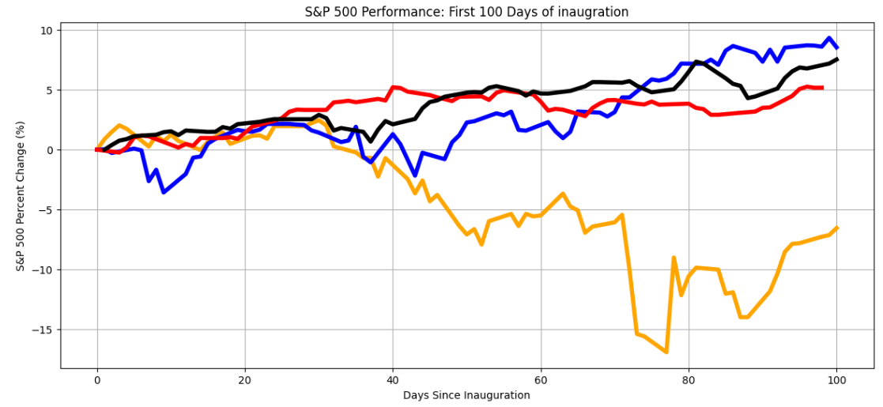
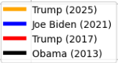
Background
The S&P 500 (Standard’s & Poor’s 500) tracks the top 500 largest publicly traded companies
Movement of S&P reflects a broader economic trend
Many factors like international/political events, macroeconomic trends affect S&P price
It’s hard to predict!!

Slide 3

Purpose
This project focuses on past movement of key financial indicators, ignoring other influences
See how effective a simple model like a Linear Regression works with a complex index.
Create a model that predicts future price using movement from 60 previous days
Hypothesis
H : Indicators such as Dow Jones index, US GDP, CPI, HPI, and Foreign Exchange have no correlation with the price of S&P 500
0
https://money.cnn.com/2015/11/29/

Slide 4
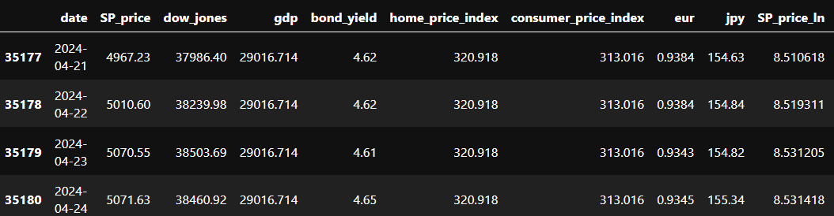
Features
Data was pulled from a variety of sources
This project uses daily/monthly/quarterly data from 1/1/1987 to 3/25/2025 – about 38 years
Dependent variable is the S&P 500 Price
Feature variables:
S&P 500, Dow Jones index, US GDP, USD/EUR, USD/JPY, Home Price Index (HPI), Consumer Price Index (CPI), Federal Bond Yield.
All are public information and relatively known to common people.

Slide 5
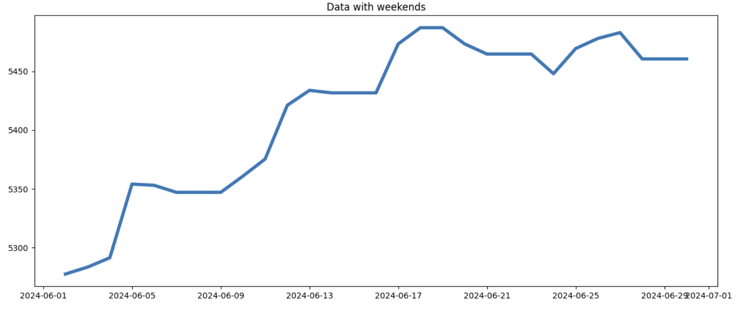
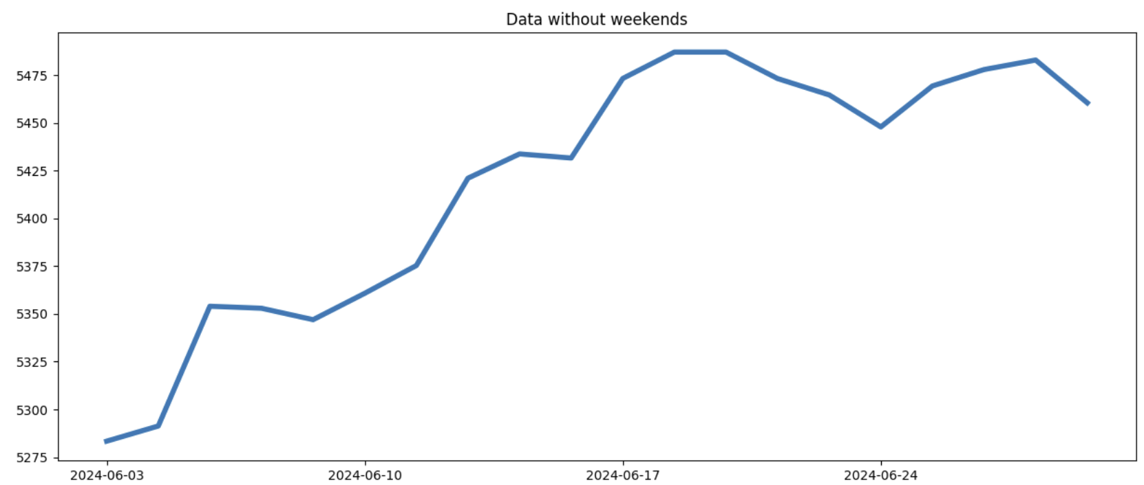
Time Series Features
Used ffill() to create continuous data for non-daily data
Filtered out weekends since market is closed -> affects accuracy
Data with exponential growth was linearized using log
Was determined by visualizing each data

Slide 6
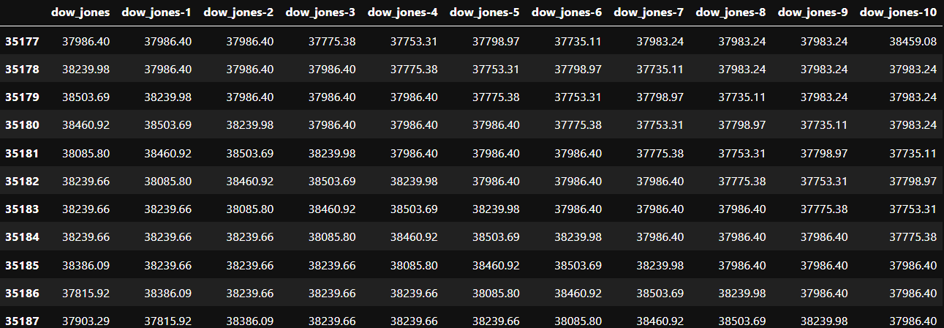
Feature Engineering
For each daily feature, we added 60 extra features for each of the 60 previous days
The linear Regression we developed uses 480 total features (8 features × 60 days)
From there, we selected the highest influencing features to remove redundancy
Implemented a greedy model

Slide 7
Model
Used scikit-learn Linear Regression
Data used for training were standardized
1 – Selecting influencing features
Fits all 480 features to the linear regression model and select features with highest correlation coefficient
2 – Values are first normalized for equal weights between the features.
We used adjusted R^2 as our optimization function.
Select the features (Greedy model). For each features, the model keeps it if the addition of the feature improves the overall R^2
3 – Testing the model
A function for testing takes in a date and predicts the movement for the next 15 days using the model

Slide 8
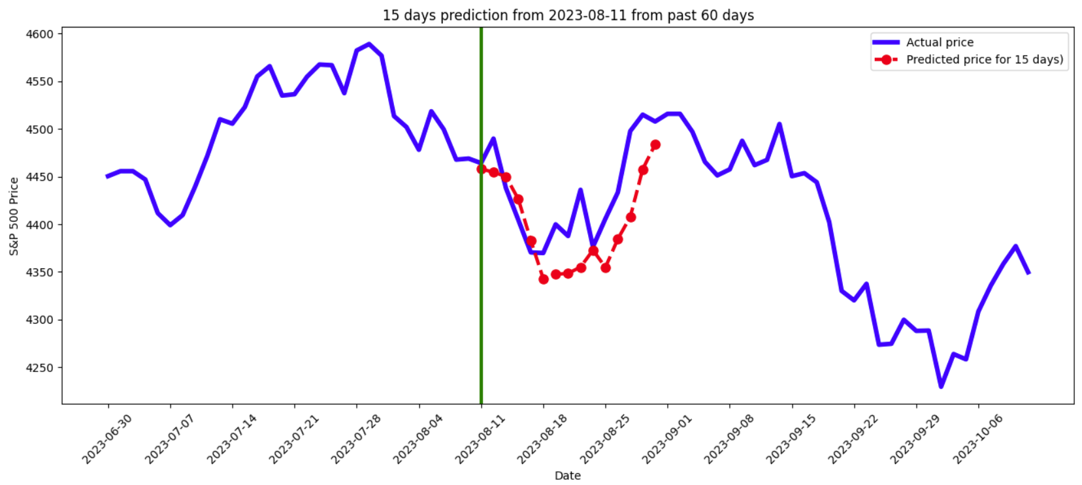
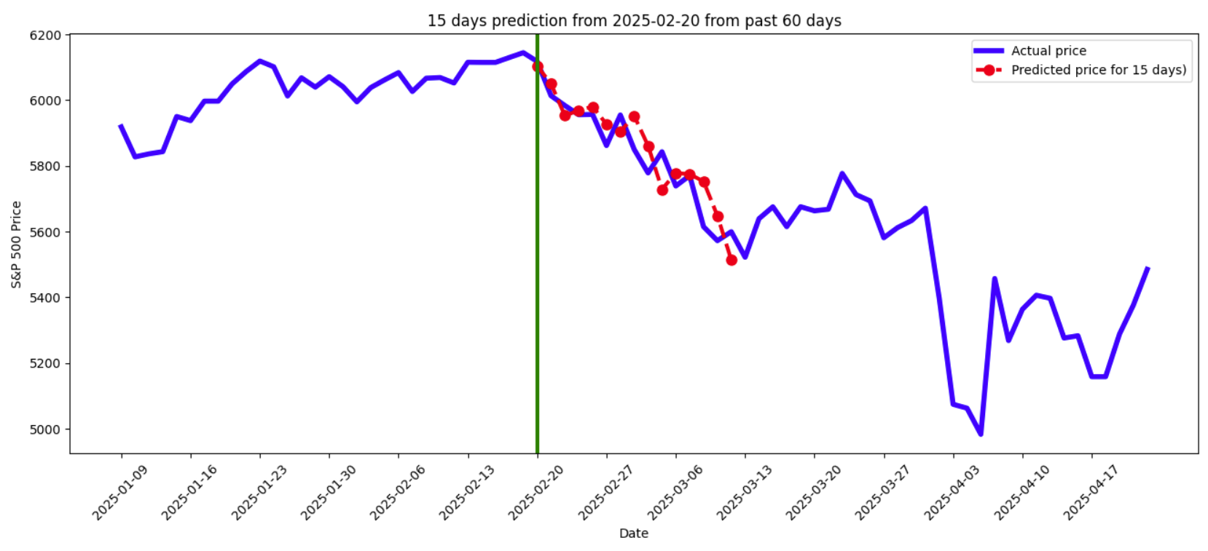
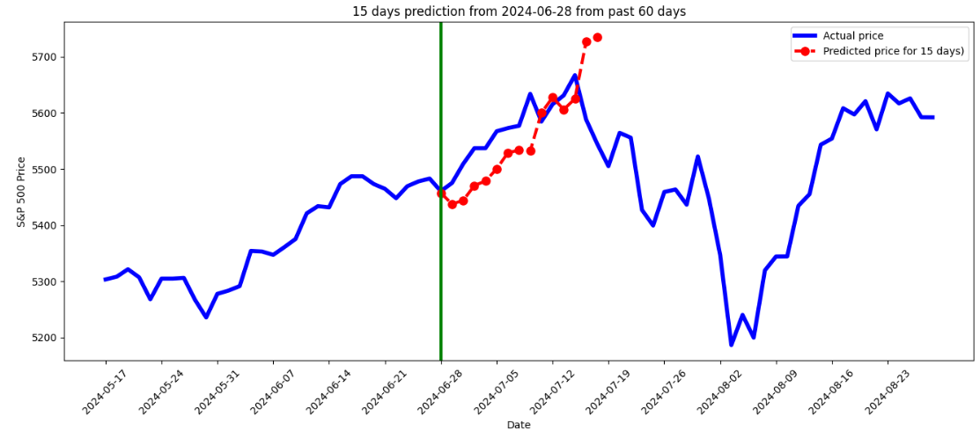
Result
Good Results↓→
Not So Good Result↓

Slide 9
Conclusion

Slide 10
Improvements/Discussion

